Slide 1

Practical 1

Slide 2
Oracle Database
A database is collection of data files plus programs that manipulate those data files.
Two types of information stored in an Oracle Database
User data, relevant to a particular application
System data, that the database needs to manage itself
Using Relational Database System

Slide 3
Relational Database
A relational Database is an extremely simple way of thinking about and managing the data used in a business.
Oracle being a relational database management system turns a piece of data into information by organizing it.
Oracle lets you do three things :
* Lets you put data into it
* keeps the data
* Lets you get the data out and work with it
Oracle supports this in-keep-out approach and provides clever tools that allow you considerable sophistication in how the data is captured, edited, modified, and put in; how you keep it securely
and how you get it out to manipulate and report on it.

Slide 4
Why it is called Relational?
ORACLE stores information in tables.
Tables can be related to each other if they each have a column with a common type of information.
This relationship is the basis for the name relational database.
Example:
LOCATION
WEATHER
City
Temperature
Humidity
Condition
City
Country
Athens
97
89
Sunny
Athens
Greece
Chicago
66
88
Rain
Chicago
United States
Paris
81
62
Cloudy
Paris
France
Notes:
Suppose you need to know in which country a particular city is located.For any city in WEATHER table, you can simply look at the LOCATION table, find the name in the City column, look over at the Country column in the same row, and see the Country's name.

Slide 5


Continuous Innovation
Database Vault
Grid Computing
In-Memory Database Cache
Automatic Storage Mgmt
Self Managing Database
XML Database
Oracle Data Guard
Real Application Clusters
Flashback Query
Virtual Private Database
Built in Java VM
Partitioning Support
Built in Messaging
Object Relational Support
Multimedia Support
Data Warehousing Optimizations
Parallel Operations
Distributed SQL & Transaction Support
Cluster and MPP Support
Multi-version Read Consistency
Client/Server Support
Platform Portability
Commercial SQL Implementation
Oracle 8i
Oracle 8
Oracle 7
Oracle 6
Oracle 5
Oracle 10g
Oracle 2
Oracle 9i

Slide 6
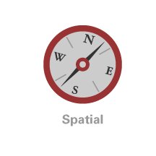
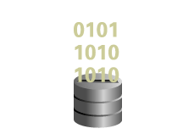








Integrating Unstructured Data
New in Oracle Database 11g
RFID
DICOM
3D
Binary XML
Images

Slide 7
Enabling Innovation with Oracle Database 11g
Better understanding of business in all types of data
Managing data growth
Improving the quality of service at lower cost
Change management facility
Notes:
To appreciate how Oracle Database 11g will help customer innovate their business, we’ll walk through each of the challenges identified here in turn.

Slide 8
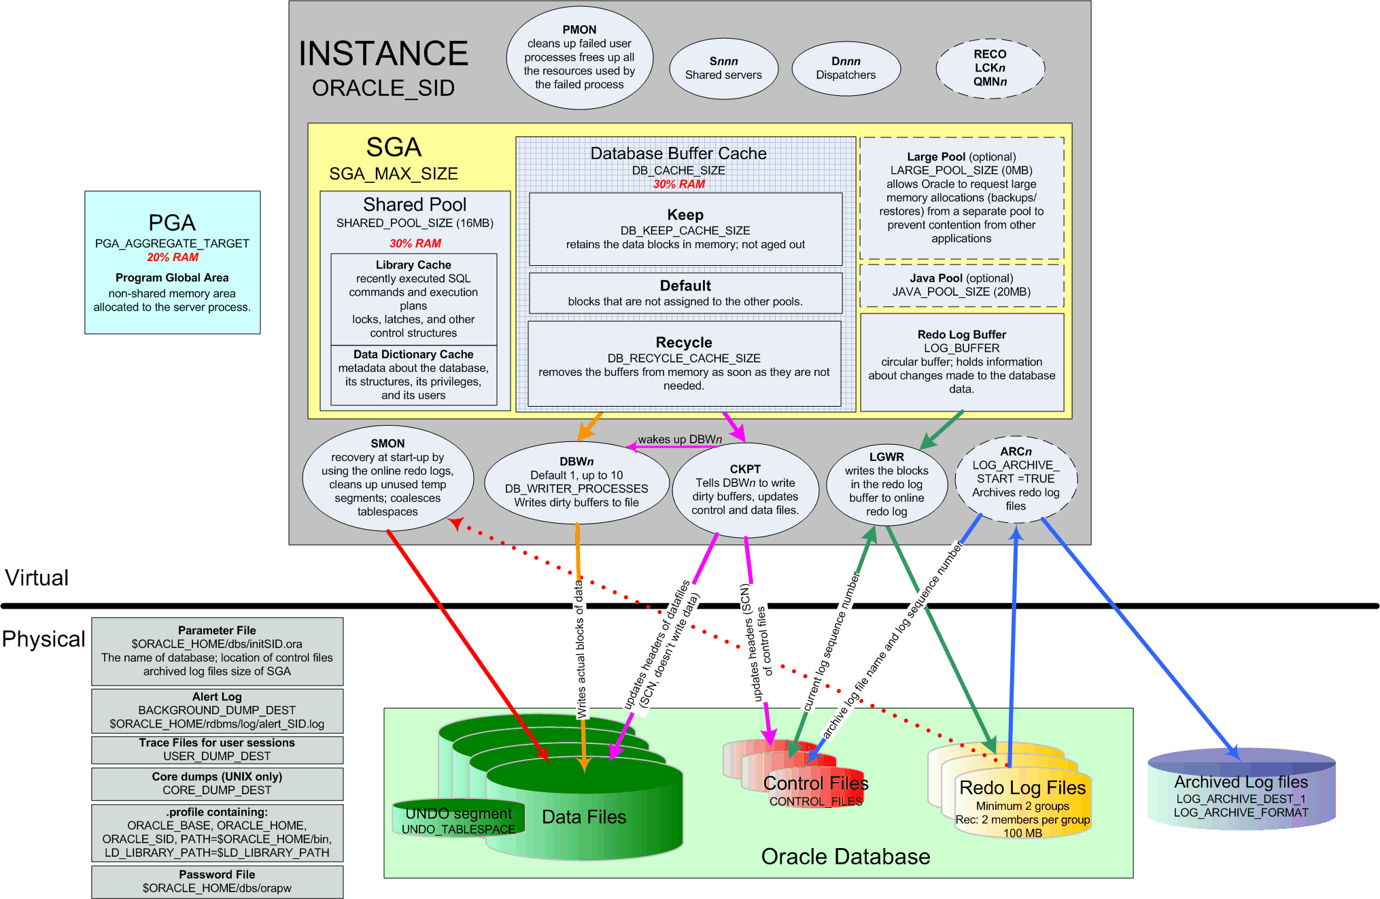
Oracle Architecture Overview

Slide 9
Oracle Server
Consist of:
  Oracle Database
  Oracle Instance
Oracle server supports SQL to define and manipulate data, PL/SQL – to control the flow of SQL, to use variables, and to provide error-handling procedures.
Oracle also can be accessed through general purpose programming languages such C or Java.

Slide 10
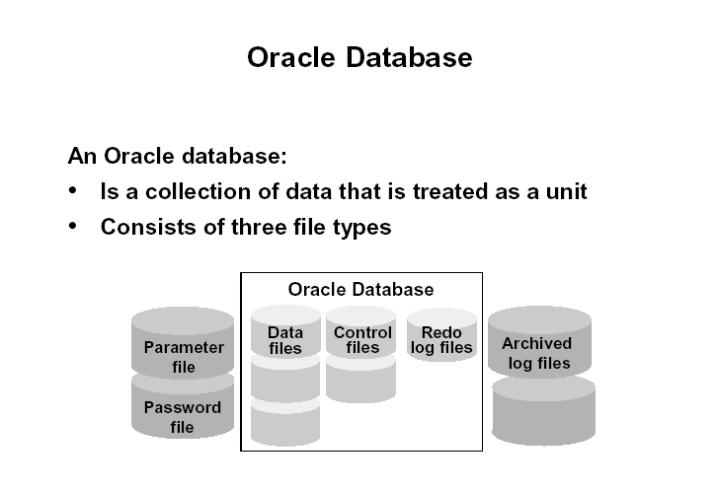
Oracle Database

Slide 11
Oracle Database
Parameter file – there are two types of parameter files.
The init.ora file (also called the PFILE) is a static parameter file. It contains parameters that specify how the database instance is to start up. For example, some parameters will specify how to allocate memory to the various parts of the system global area.
The spfile.ora is a dynamic parameter file. It also stores parameters to specify how to startup a database; however, its parameters can be modified while the database is running.
Password file – specifies which *special* users are authenticated to startup/shut down an Oracle Instance.
Archived redo log files – these are copies of the redo log files and are necessary for recovery in an online, transaction-processing environment in the event of a disk failure.

Slide 12
Oracle Database
Datafiles – these contain the organization's actual data.
Redo log files – these contain a chronological record of changes made to the database, and enable recovery when failures occur.
Control files – these are used to synchronize all database activities and are covered in more detail in a later module.

Slide 13
Database
A database is a collection of data on disk in one or more files on a database server that collects and maintains related information.
The database consists of various physical and logical structures. The table is the most important logical structure having rows and columns.
A database provides a level of security to prevent unauthorized access to the data.
Files composing a database fall into two broad categories: database files and non-database files.
Database files contain data and metadata; non-database files contain initialization parameters, logging information, and so forth.

Slide 14
Instance
An Oracle instance is composed of a large block of memory allocated
in an area called the System Global Area (SGA), along with a number of background processes that interact between the SGA and the database files on disk.
An Oracle Instance consists of two different sets of components:
the first component set is the set of background processes (PMON, SMON, RECO, DBW0, LGWR, CKPT, D000 and others).
  These will be covered later in detail – each background process is a computer program.
  These processes perform input/output and monitor other Oracle processes to provide good performance and database reliability.

Slide 15
Instance
The second component set includes the memory structures that comprise the Oracle instance.
  When an instance starts up, a memory structure called the System Global Area (SGA) is allocated.
  At this point the background processes also start.
An Oracle Instance provides access to one and only one Oracle database

Slide 16
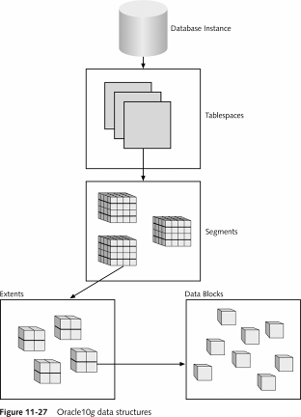
Oracle 11g Data Structures
Tablespace
  One or more Data Files
Segment
  Partitioned Data
Extent
  Growth rule for segment
Data block
  Database storage data block
  Operating system blocks

Slide 17
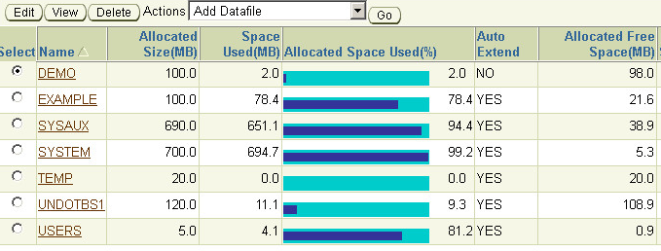
Tablespaces
One or more Data files
Stores all database structures + data
  Tables, data, views, sp’s etc…

Slide 18
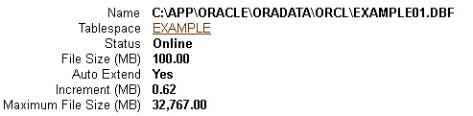
Datafiles
.dbf extensions
Store tablespace contents
Stored in Oracle_Base\oradata\SID
Use OEM to view and modify
Grow via Extents

Slide 19
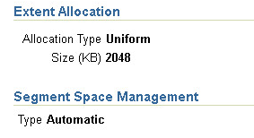
Extent
Sequence of Data Blocks
When an insert grows beyond the data file size allocation, a new extent is added.
More efficient to add groups of data blocks vs. individual blocks.

Slide 20
User and server processes
The processes shown in the figure are called user and server processes. These processes are used to manage the execution of SQL statements.
A Shared Server Process can share memory and variable processing for multiple user processes.
A Dedicated Server Process manages memory and variables for a single user process.
A Guide to Oracle9i

Slide 21
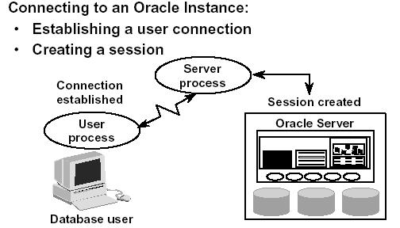
Connecting to an Oracle Instance – Creating a Session
A Guide to Oracle9i

Slide 22
Connecting to an Oracle Instance – Creating a Session
System users can connect to an Oracle database through SQLPlus or through an application program like the Internet Developer Suite (the program becomes the system user). This connection enables users to execute SQL statements.
The act of connecting creates a communication pathway between a user process and an Oracle Server. As is shown in the figure , the User Process communicates with the Oracle Server through a Server Process. The User Process executes on the client computer. The Server Process executes on the server computer, and actually executes SQL statements submitted by the system user.

Slide 23
Connecting to an Oracle Instance – Creating a Session
The figure shows a one-to-one correspondence between the User and Server Processes. This is called a Dedicated Server connection. An alternative configuration is to use a Shared Server where more than one User Process shares a Server Process.
Sessions: When a user connects to an Oracle server, this is termed a session. The User Global Area is session memory and these memory structures are described later in this document. The session starts when the Oracle server validates the user for connection. The session ends when the user logs out (disconnects) or if the connection terminates abnormally (network failure or client computer failure).
A Guide to Oracle9i

Slide 24
Connecting to an Oracle Instance – Creating a Session
A user can typically have more than one concurrent session, e.g., the user may connect using SQLPlus and also connect using Internet Developer Suite tools at the same time. The limit of concurrent session connections is controlled by the DBA.
If a system users attempts to connect and the Oracle Server is not running, the system user receives the Oracle Not Available error message.
A Guide to Oracle9i

Slide 25
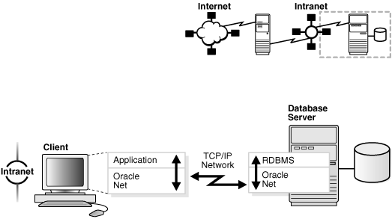
Client/Server Application Connections

Slide 26
Client/Server Application Connections
Oracle Net enables connections from traditional client/server applications to Oracle Database servers.
Figure shows how Oracle Net enables a network connection between a client and a database server. Oracle Net is a software component that resides on both the client and the database server.
Oracle Net is layered on top of a network Oracle protocol support—rules that determine how applications access the network and how data is subdivided into packets for transmission across the network.
In this illustration, Oracle Net communicates with the TCP/IP protocol to enable computer-level connectivity and data transfer between the client and the database server.

Slide 27
Installing an Oracle11g Database
For the Oracle 11g R2 Installation Guide refers to the pdf file provided in WBLE.
(Oracle 11g R2 Installation Guide.pdf)

Slide 28
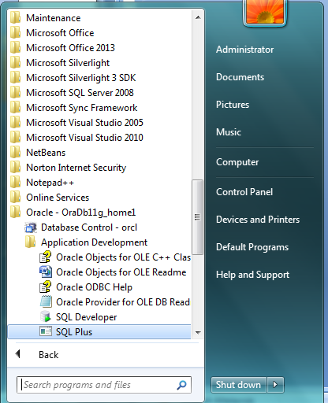
Accessing Oracle Database with SQL*Plus
To start SQL*Plus, from the Start menu, select All Programs, then Oracle - HOME_NAME, then Application Development, and then SQL Plus.

Slide 29
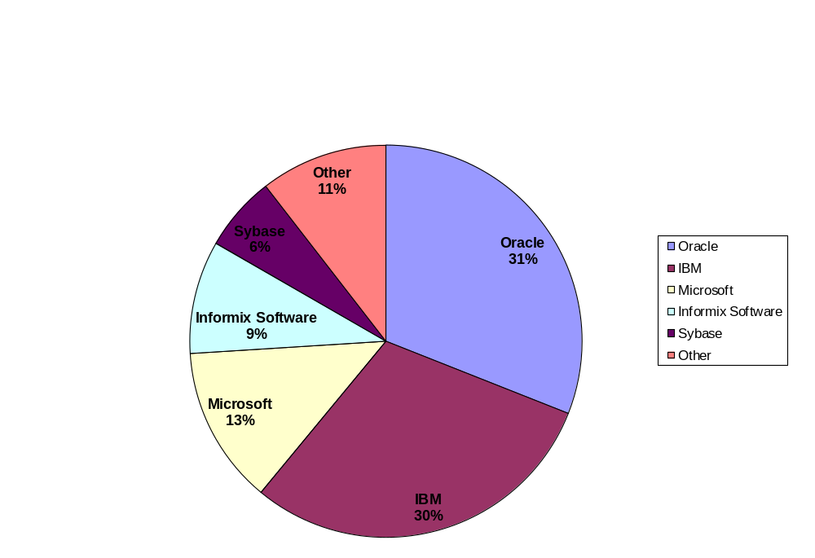
Database Market Share

Slide 30
Oracle vs. Access and MySQL
Access
  One .mdb file contains all objects
  Limited roles/permissions
MySQL
  Three files per table
  Permissions based on user, database, and host
Oracle
  Many files
  Many roles/permissions possible

Slide 31
Why Companies Should use Oracle?
Scalability: Can be used on all windows and many different UNIX operating systems.
Oracle is much more stable and reliable the DB2 and SQL Server 7.0
Oracle delivers the most Java and Internet specific features of popular databases. Users can create internal database programs like stored procedures and triggers in Java
Oracle is much more suited for large volume web site processing due in part to its internal programming languages and its incorporation of Java and other web-enabled programming languages.

Slide 32
Why Companies Should use Oracle?
Oracle has multiversioning concurrency. This function avoids making one user wait for another user to finish making changes to the database. Other databases make database readers wait for a database writer to finish making changes, but Oracle never does this; its readers can always read any row in the database without waiting. This feature is why Oracle is able to push through more transactions per user than other database products.
Has large database partitioning, which helps businesses keep monster, gigabyte-size databases under control.
Offers market-leading support for multimedia objects

Slide 33
The Northwoods University
Student Registration Database
Northwoods University
Decided to replace its aging mainframe-based student registration system with a more modern client/server database system
School officials want students to be able to retrieve course availability information, register for courses, and print transcripts using personal computers located in the student computer labs

Slide 34
The Northwoods University
Student Registration Database (cont)
Faculty members must be able to retrieve student course lists, drop and add students, and record course grades
Faculty members must also be able to view records for the students they advise
Security is a prime concern, so student and course records must be protected by password access

Slide 35
Northwoods University
Data Requirements
Student name, address, telephone number, class (freshman, sophomore, junior, or senior), date of birth, PIN (personal identification number), and advisor ID
Course call number (such as MIS 101), course name, credits, location, duration, maximum enrollment, instructor, and term offered
Instructor name, office location, telephone number, rank, and PIN
Student enrollment and grade information

Slide 36
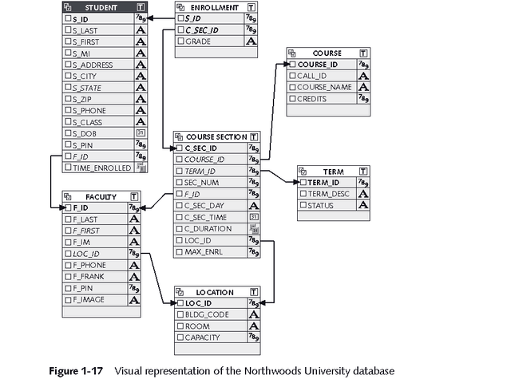
Northwoods University
Table Relationships

Slide 37
Summary
A database stores all organizational data in a central location
Database management system (DBMS) provides a central set of common functions for managing a database, including
  Inserting
  Updating
  Retrieving
  Deleting data values
Most modern databases are relational databases
  Store data in a tabular format
  Columns represent different data fields
  Rows contain individual data records

